Slide 1
Transport Layer

Slide 2

UDP
User Datagram Protocol

Slide 3
How does the method of ones' complement work for UDP and TCP checksum Calculation?
Let's understand this by an example. Imagine we have a UDP segment or a TCP packet. The first thing that we do is to divide and slice it up to 16 bit pieces. Let's assume we have three 16 bit data as below.
1 0 0 1 1 0 1 0 0 1 0 1 0 1 1 0
0 0 0 0 1 0 1 1 1 0 0 0 1 1 1 0
0 0 0 0 1 1 0 1 1 1 0 0 1 1 0 0
If we add those three 16 bit data using binary addition. We get the below 16 bit data(Its simple binary addition).
1001101001010110 + 0000101110001110 + 0000110111001100 = 1011001110110000
Ones complement of our result 1011001110110000 is 0100110001001111(This is our checksum). So we need to basically send our data (which is the three binary 16 bit numbers) along with its checksum to a recieaver. The main thing to understand is, the reciever will get the data as well as the checksum we calculated.

Slide 4
The reciever will get the below things. 1 0 0 1 1 0 1 0 0 1 0 1 0 1 1 0 (data) 0 0 0 0 1 0 1 1 1 0 0 0 1 1 1 0 (data) 0 0 0 0 1 1 0 1 1 1 0 0 1 1 0 0 (data) 0 1 0 0 1 1 0 0 0 1 0 0 1 1 1 1 (Checksum) The reciever will simply add all the above 4 things. Data as well as checksum are added together. Let's try adding it. 1001101001010110 + 0000101110001110 + 0000110111001100 + 0100110001001111 = 1111111111111111
If the output of sum of 16 bit data and checksum is 1111111111111111. All fields will be 1s. Even if there is one 0, then that means errors were introduced in the data during transit.

Slide 5
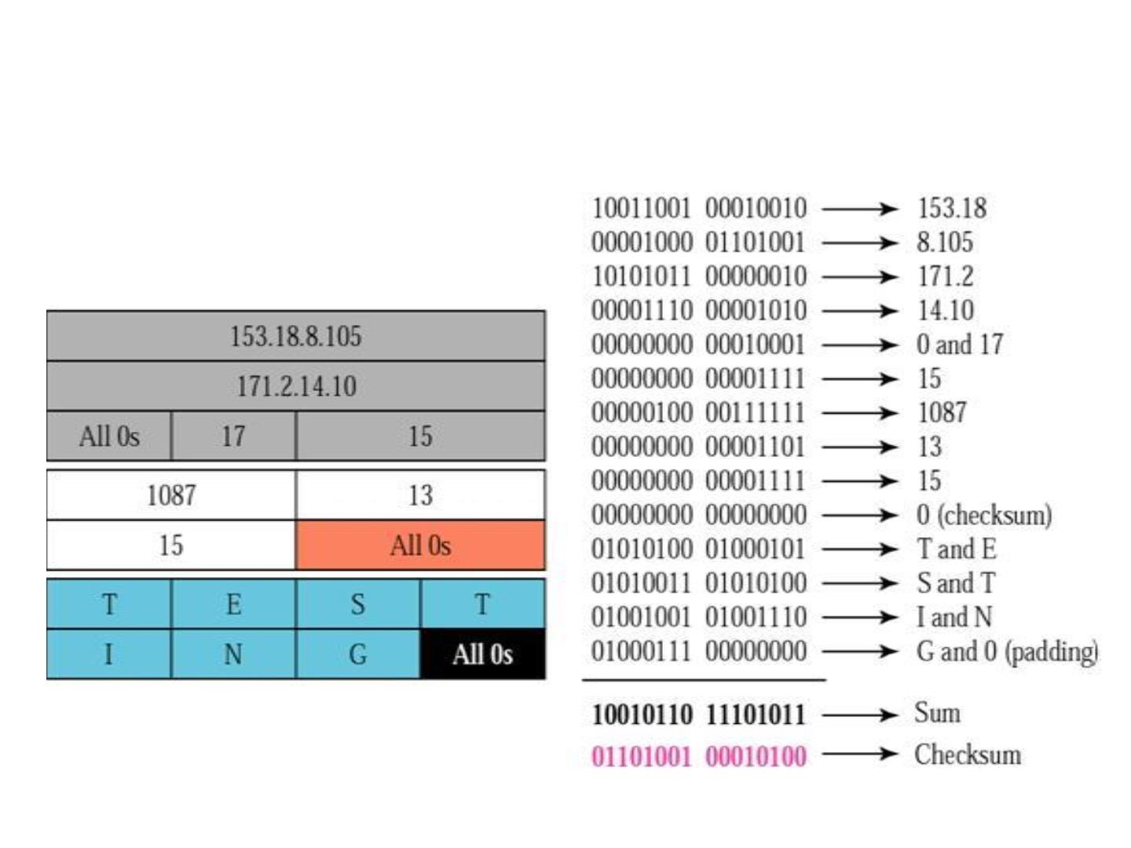
Checksum calculation at sender
side for 7 bytes of data

Slide 6
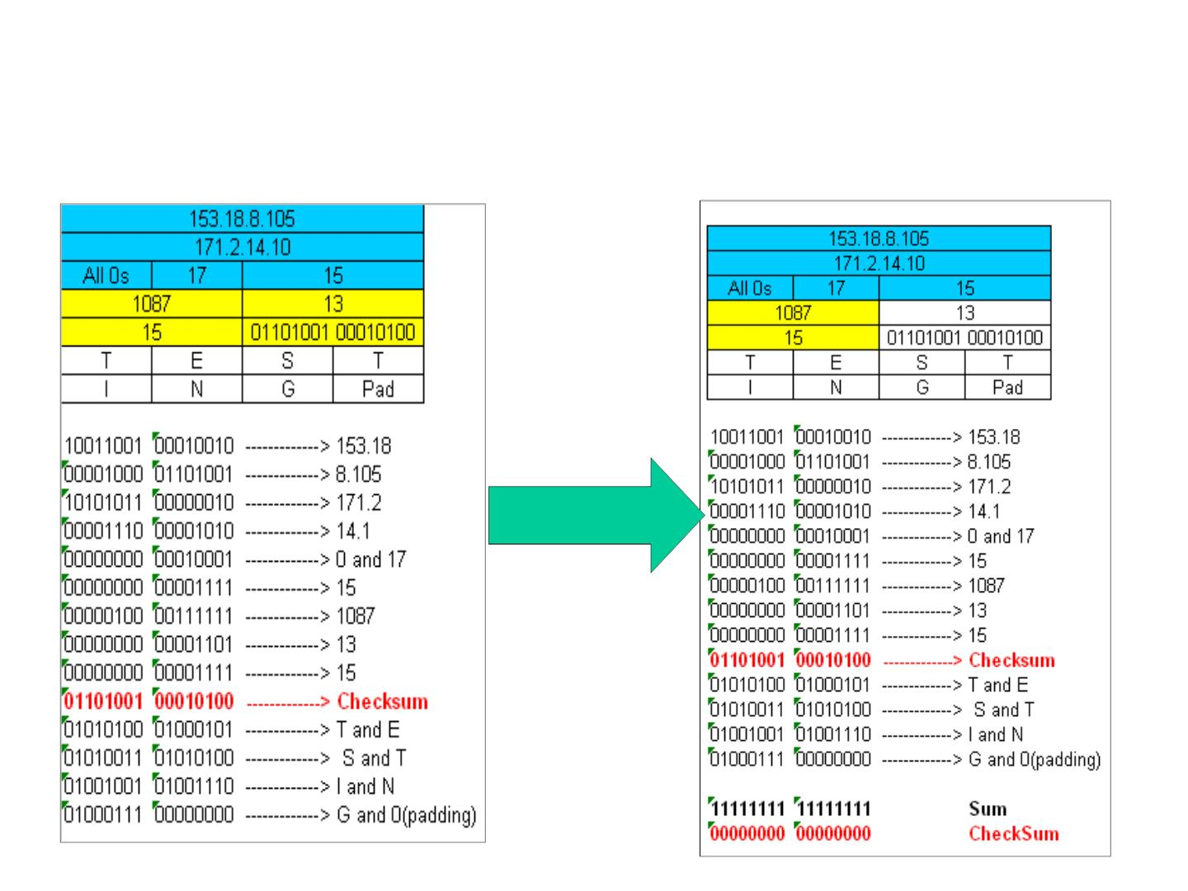
Checksum calculation at receiver side
Sender sends the UDP segment
Receiver receives the UDP segment
along with checksum filled
correctly

Slide 7
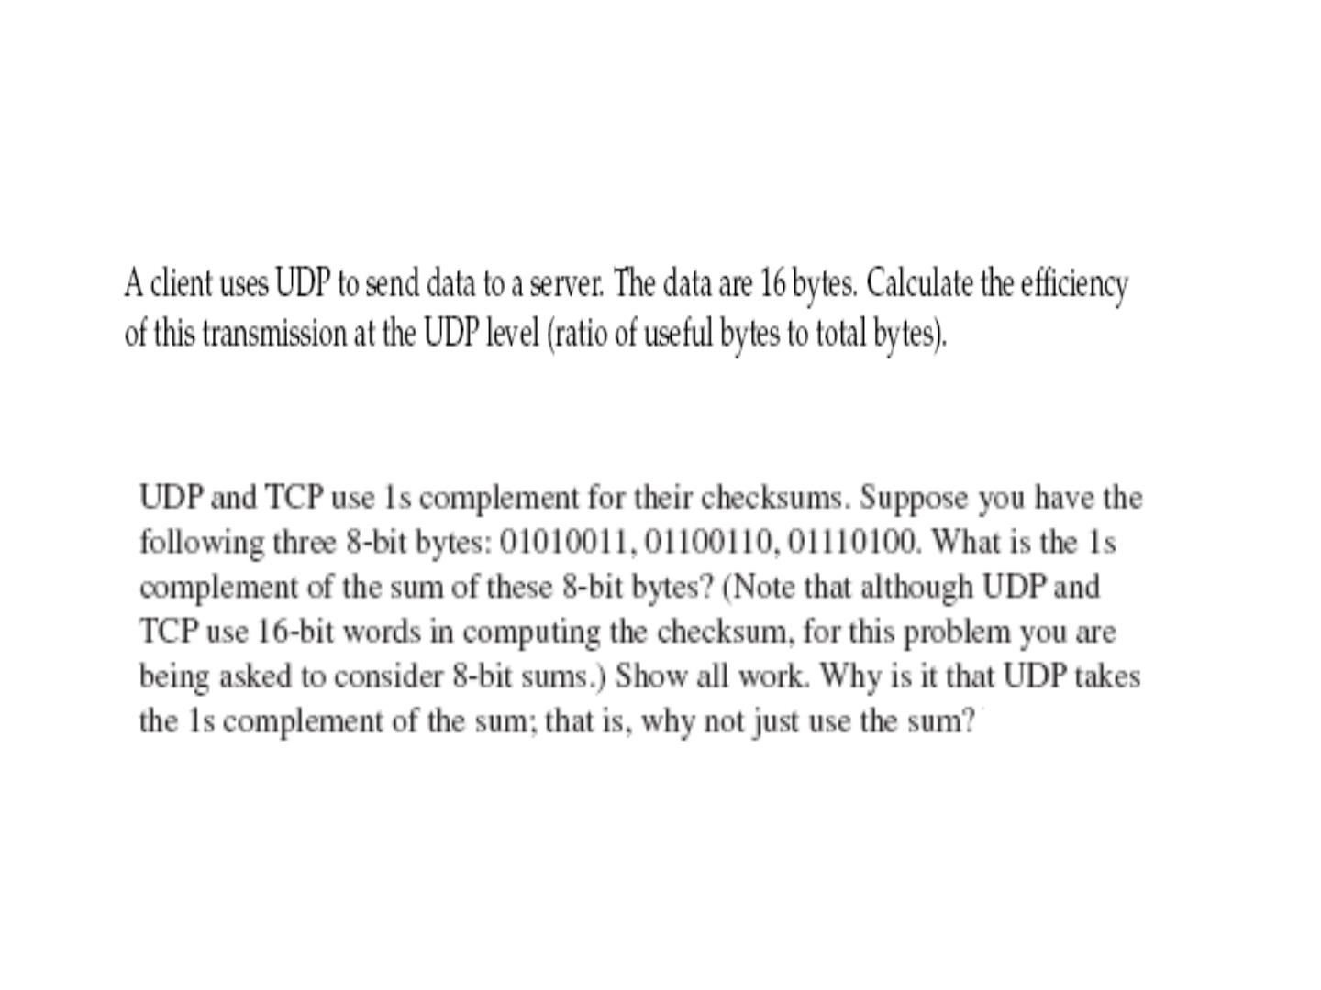
Questions..
Notes:
=16/(16+8)

Slide 8
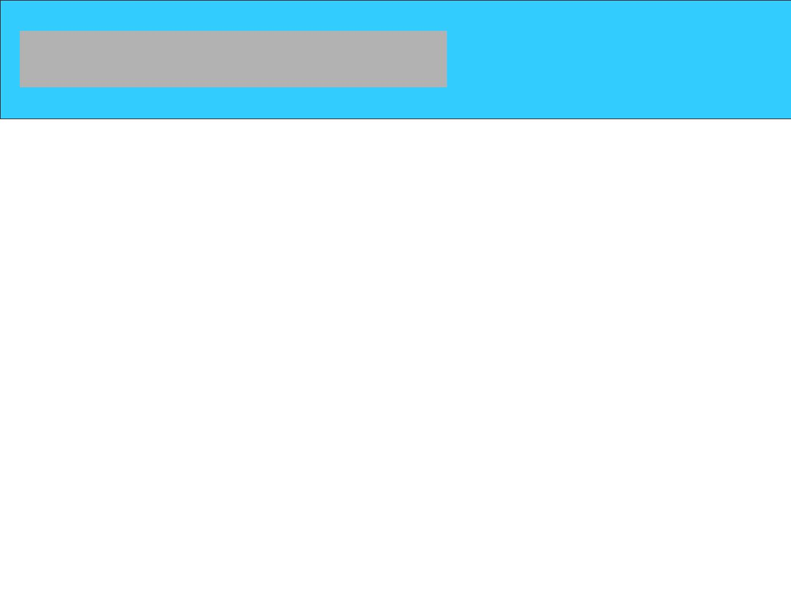
A TCP CONNECTION
TCP is connection-oriented. It establishes a virtual path between the source and destination. All of the
segments belonging to a message are then sent over this virtual path. You may wonder how TCP, which
uses the services of IP, a connectionless protocol, can be connection-oriented. The point is that a TCP
connection is virtual, not physical. TCP operates at a higher level. TCP uses the services of IP to deliver
individual segments to the receiver, but it controls the connection itself. If a segment is lost or corrupted, it is retransmitted.

Slide 9
Window Size
The Window size is considered to be one of the most important flags within the TCP header. This field is used by the receiver to indicate to the sender the amount of data that it is able to accept. The Window size field is the key to efficient data transfers and flow control. Used in bytes.

Slide 10
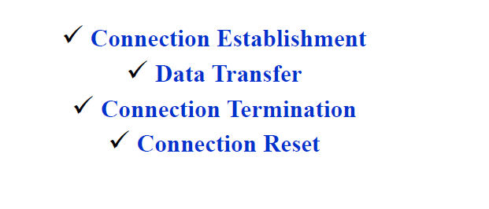

Slide 11
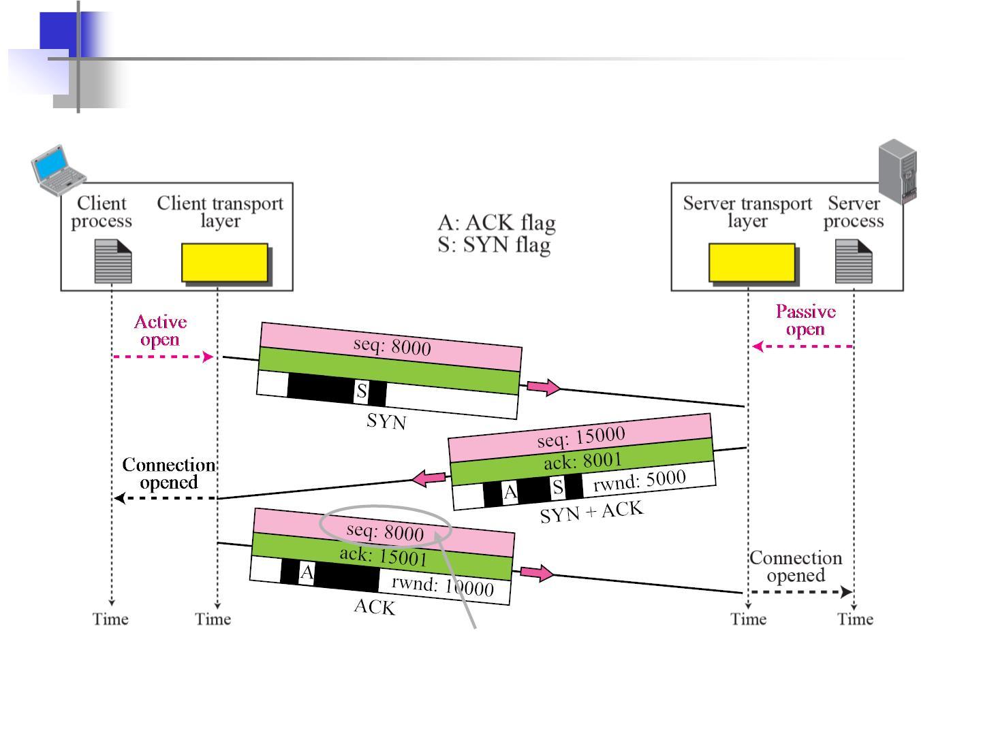
Connection establishment using three-way handshake
Means “no data” !
seq: 8001 if piggybacking

Slide 12
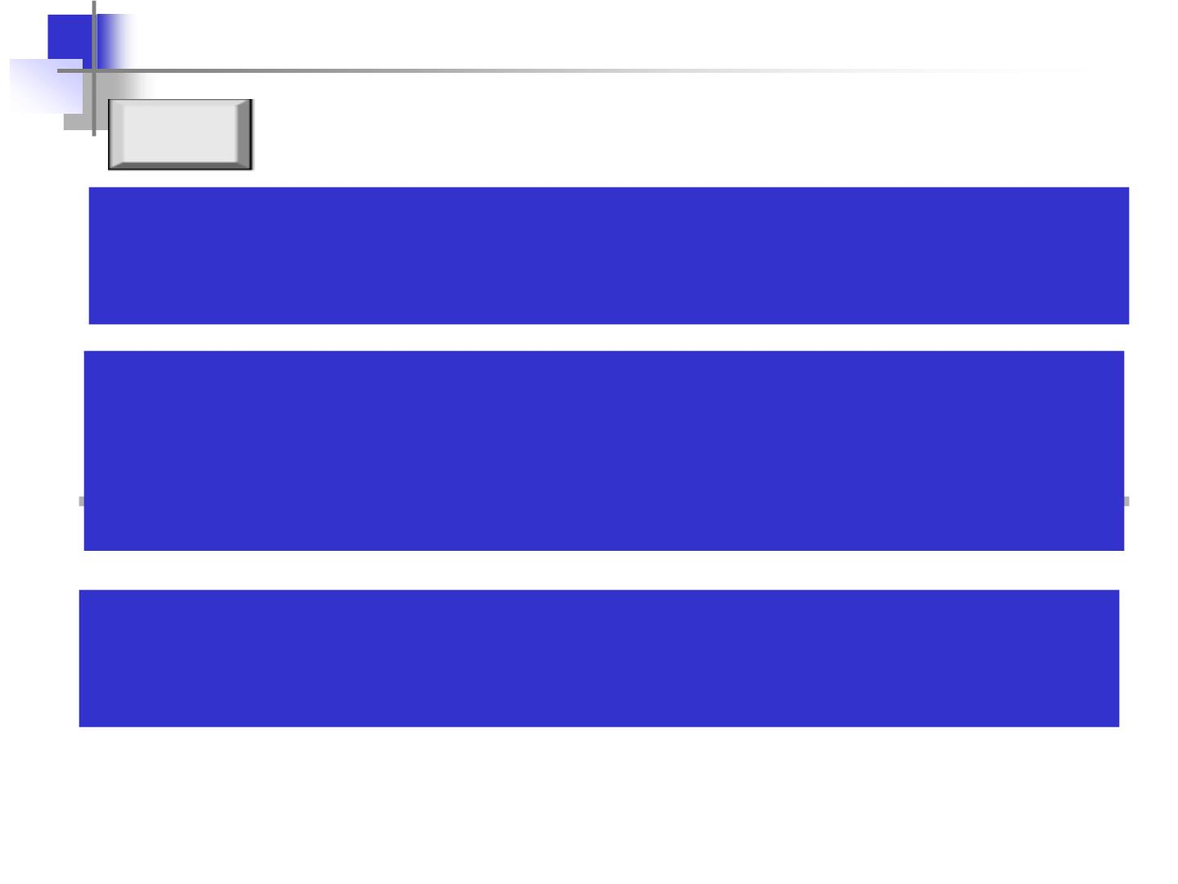
Note
A SYN segment cannot carry data, but
it consumes one sequence number.
A SYN + ACK segment cannot carry data, but does consume one sequence number.
An ACK segment, if carrying no data,
consumes no sequence number.

Slide 13
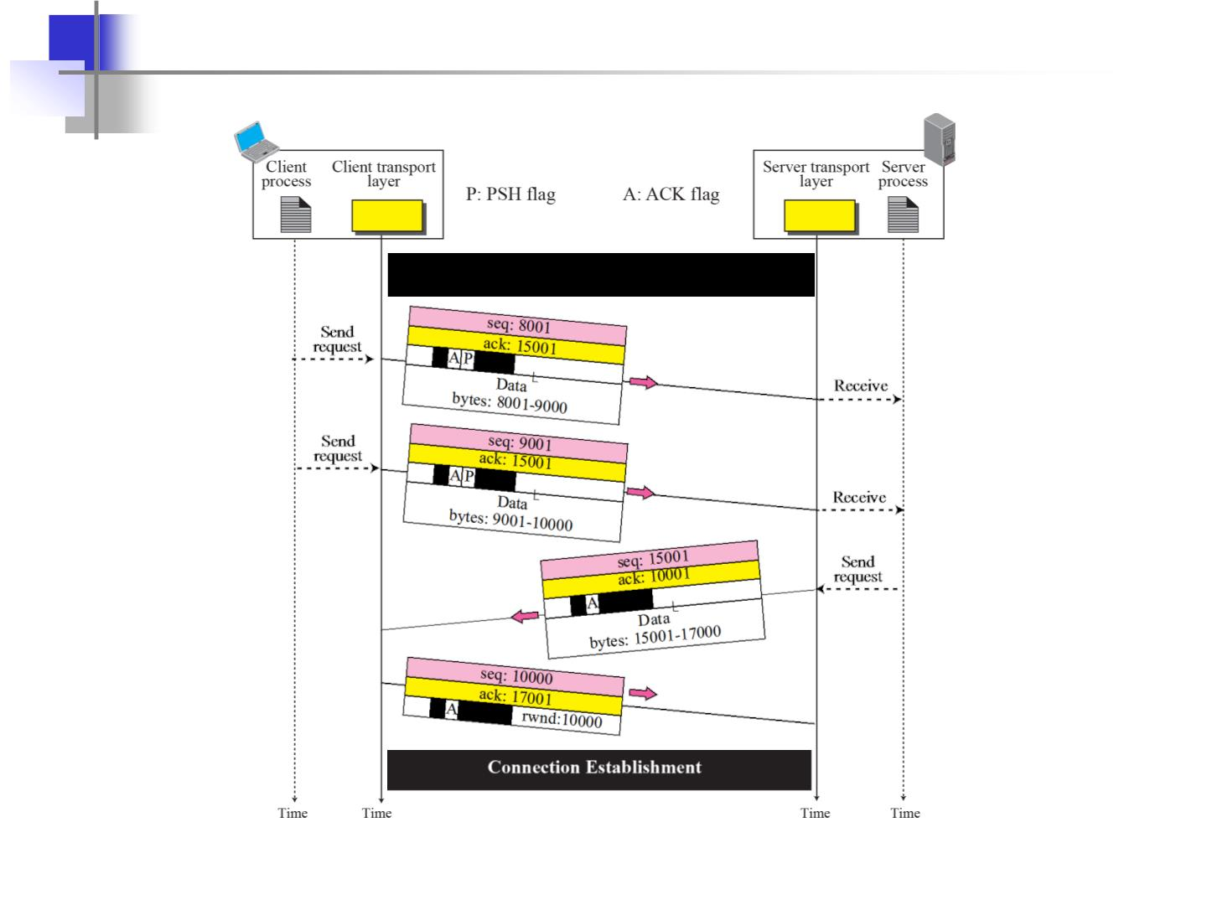
Data Transfer
Connection Termination

Slide 14
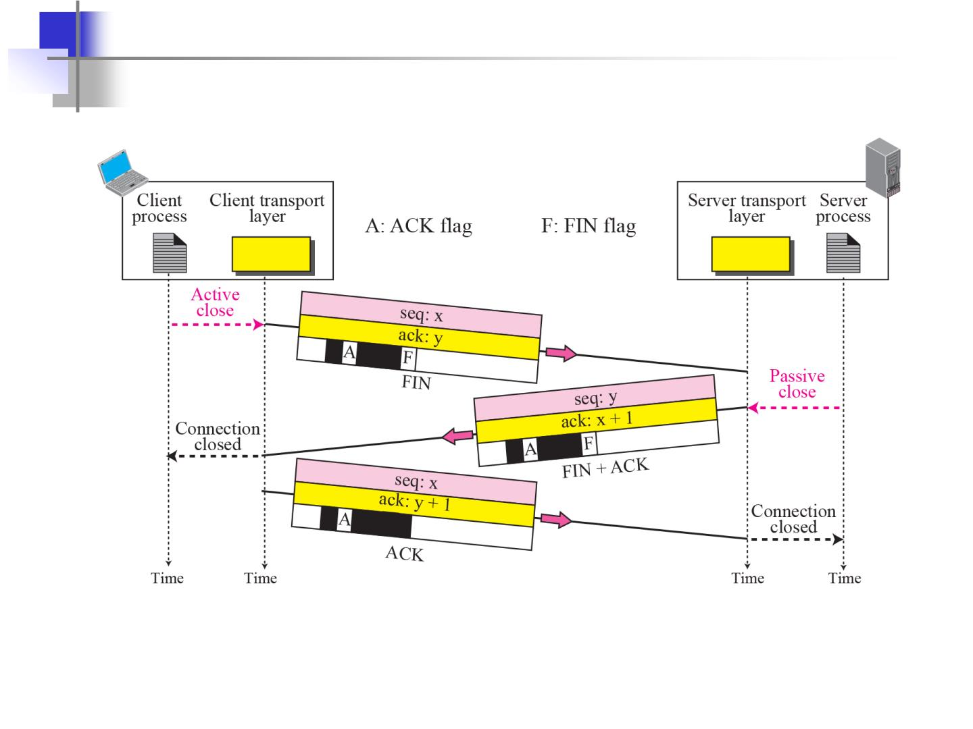
Connection termination using three-way handshake

Slide 15
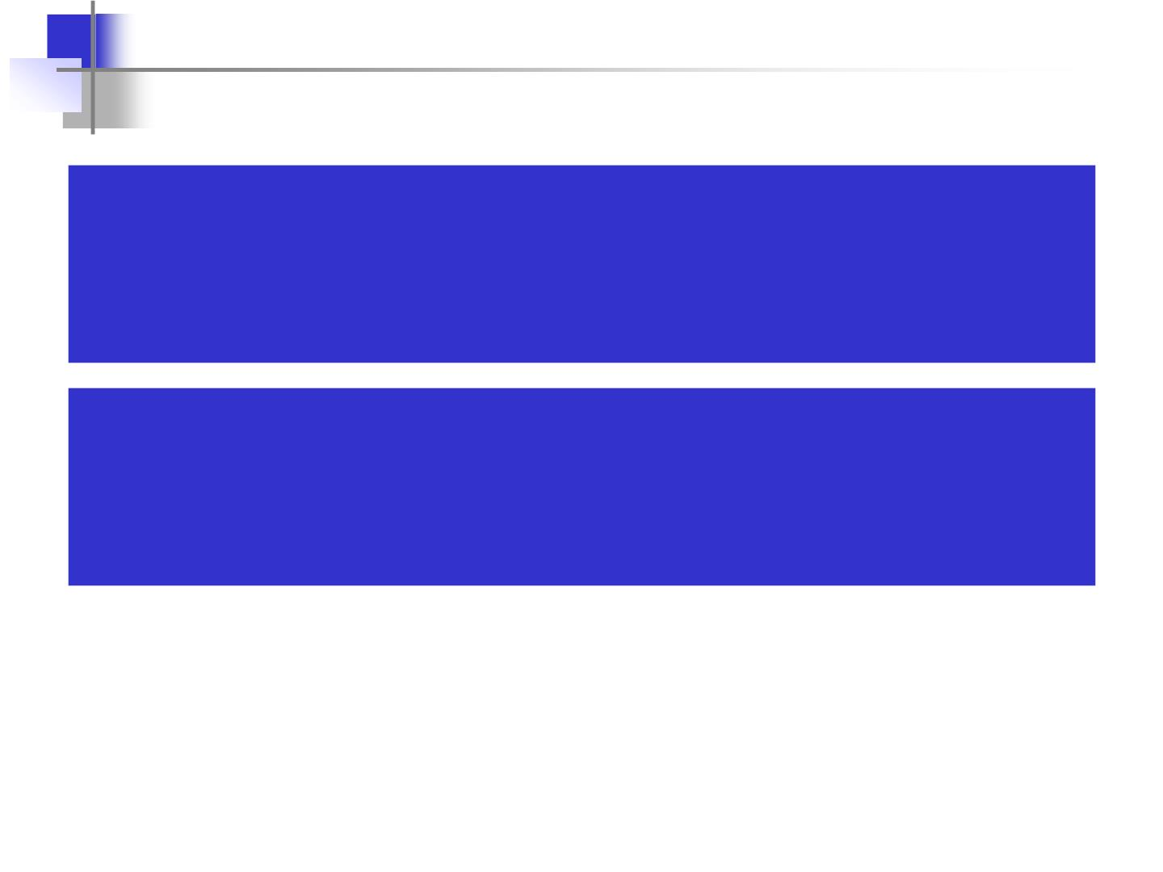
The FIN segment consumes one
sequence number if it does
not carry data.
The FIN + ACK segment consumes one
sequence number if it does
not carry data.

Slide 16
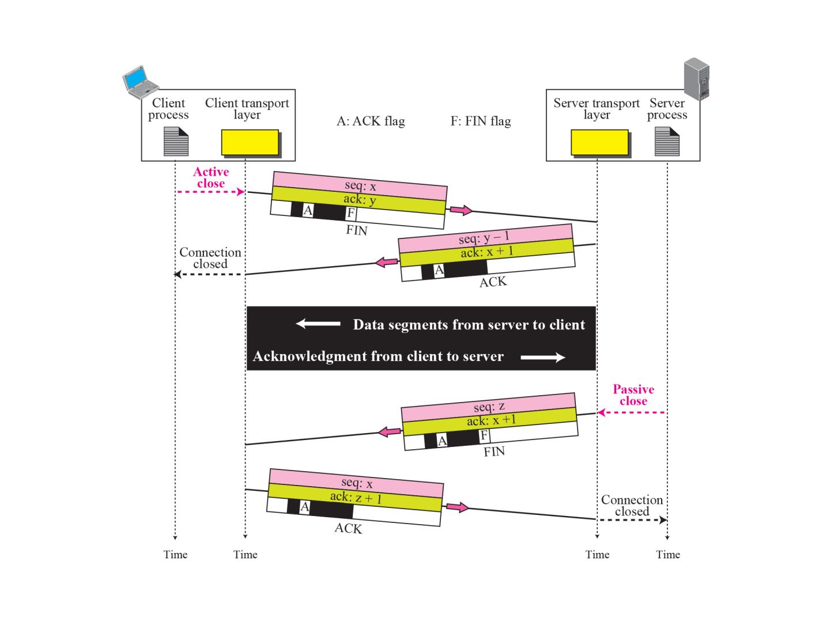
Half-Close

Slide 17
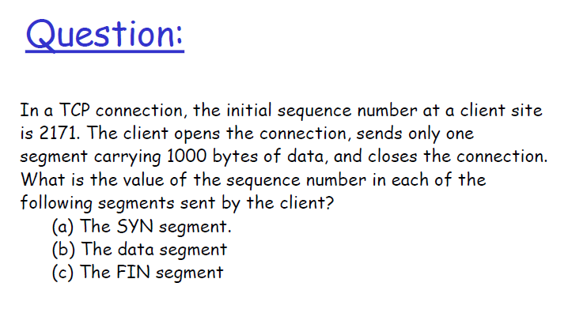

Slide 18
Solution
(a) 2171
(b) 2172
(c) 3172

Slide 19
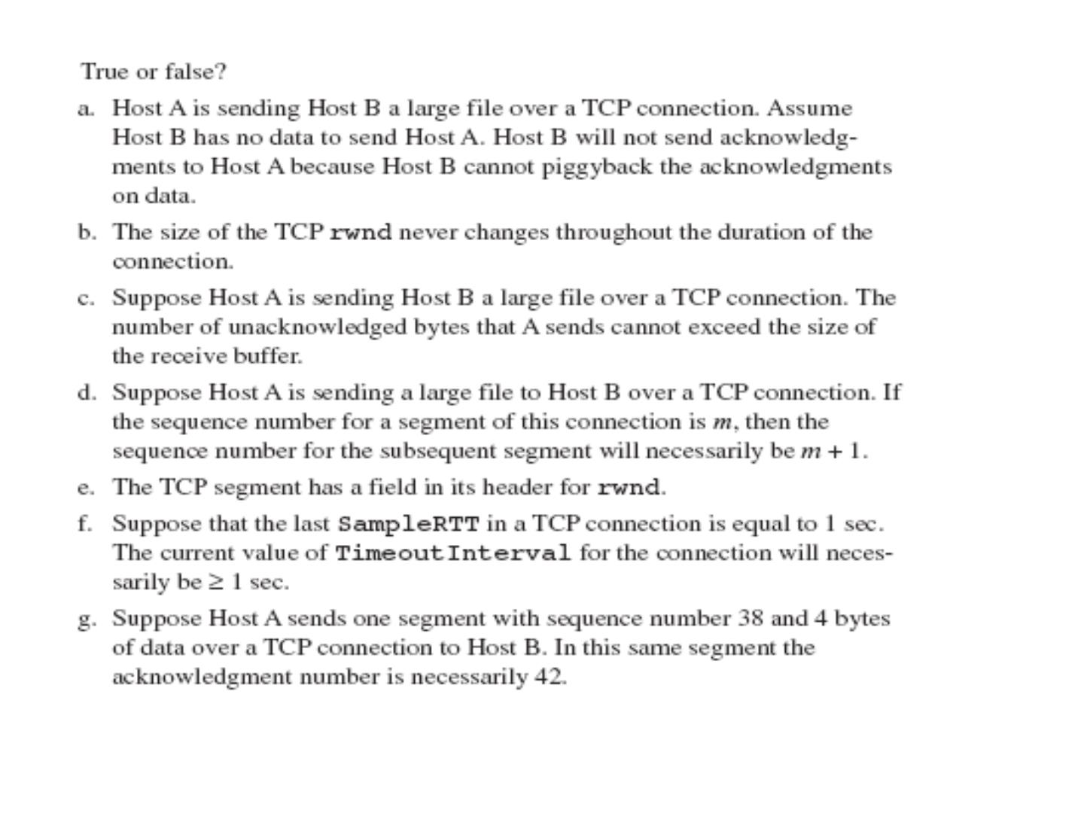
Notes:
http://web.eecs.utk.edu/~hqi/teaching/ece453f06/hw/hw7_sol.htm

Slide 20
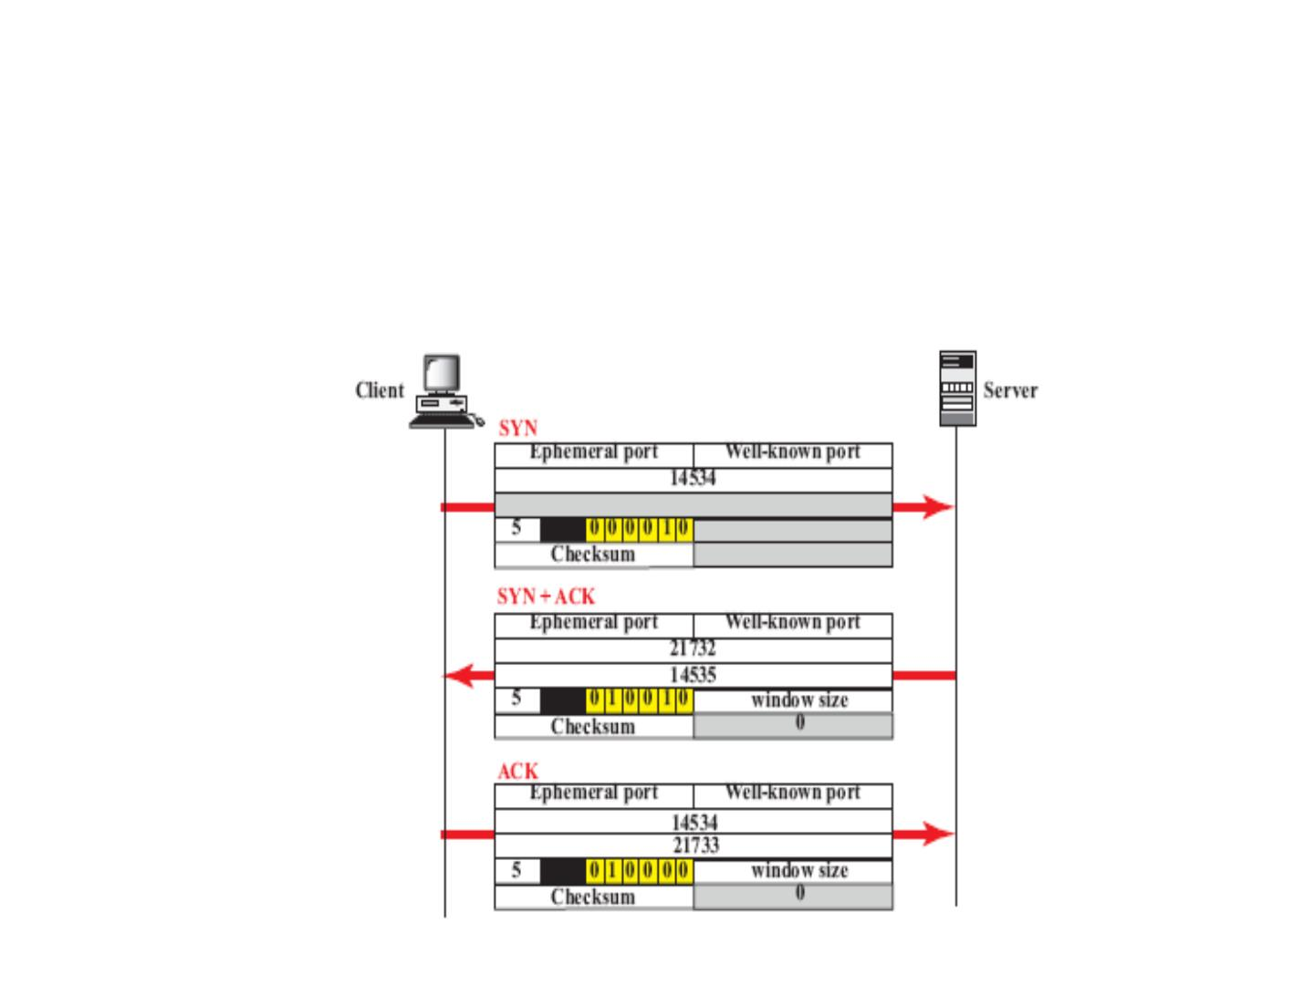
Question:
TCP opens a connection using initial sequence number (ISN) of 14,534. The
other party opens the connection with an ISN 21732. Show the three TCP
segments during the connection establishment.

Slide 21
Questions:
108

Slide 22
1. In stop-and-wait system, bandwidth of the line is 1 Mbps
and 1 bit takes 20 ms to make a round trip. What is the
bandwidth-delay product? If the system data frames are
1000bits in length what is the utilization percentage of the
link?
2. What is the Utilization percentage of the link if the link uses
go-back-n with a 15 frame sequence?
112

Slide 23
3. Consider transferring an enormous file of L bytes from Host A to
Host B.
a) What is the maximum value of L such that TCP sequence numbers
are not exhausted? Recall that the TCP sequence number field has
4 bytes.
b) Assume an MSS of 1460 bytes. For the L you obtain in (a), find
how long it takes to transmit the file. Assume that a total of 66
bytes of transport, network, and data-link header are added to each
segment before the resulting packet is sent out over a 10 Mbps
link. Ignore flow control and congestion control so A can pump
out the segments back to back and continuously.
Note: MSS is the maximum size of user data carried by any segment
in a TCP connection. In SYN segment, using TCP options header,
each TCP entity informs to the other about which MSS wants to use.
The smaller will be used.

Slide 24
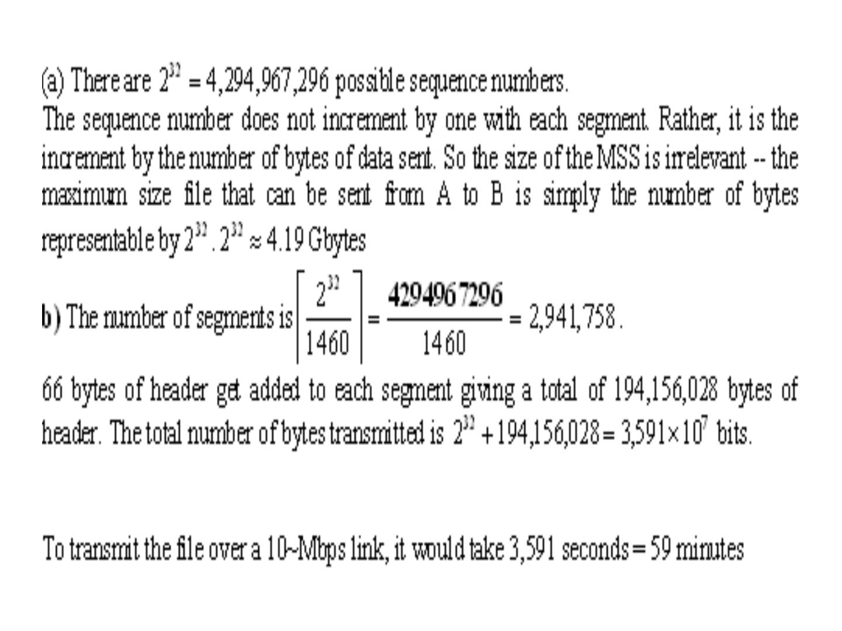
115

Slide 25
4. A system uses the Stop-and-Wait ARQ Protocol. If each
packet carries 1000 bits of data, how long does it take to send
1 million bits of data if the distance between the sender and
receiver is 5000 Km and the propagation speed is 2 x 108 m/s?
Ignore waiting, and processing delays. We assume
no data or control frame is lost or damaged.
16. Repeat above Exercise using the Go-back-N ARQ Protocol
with window size of 7. Ignore the overhead due to the header
and trailer.
17. Repeat above using the Selective-Repeat ARQ Protocol
with a window size of 4. Ignore the overhead due to the header
and the trailer.
117

Slide 26
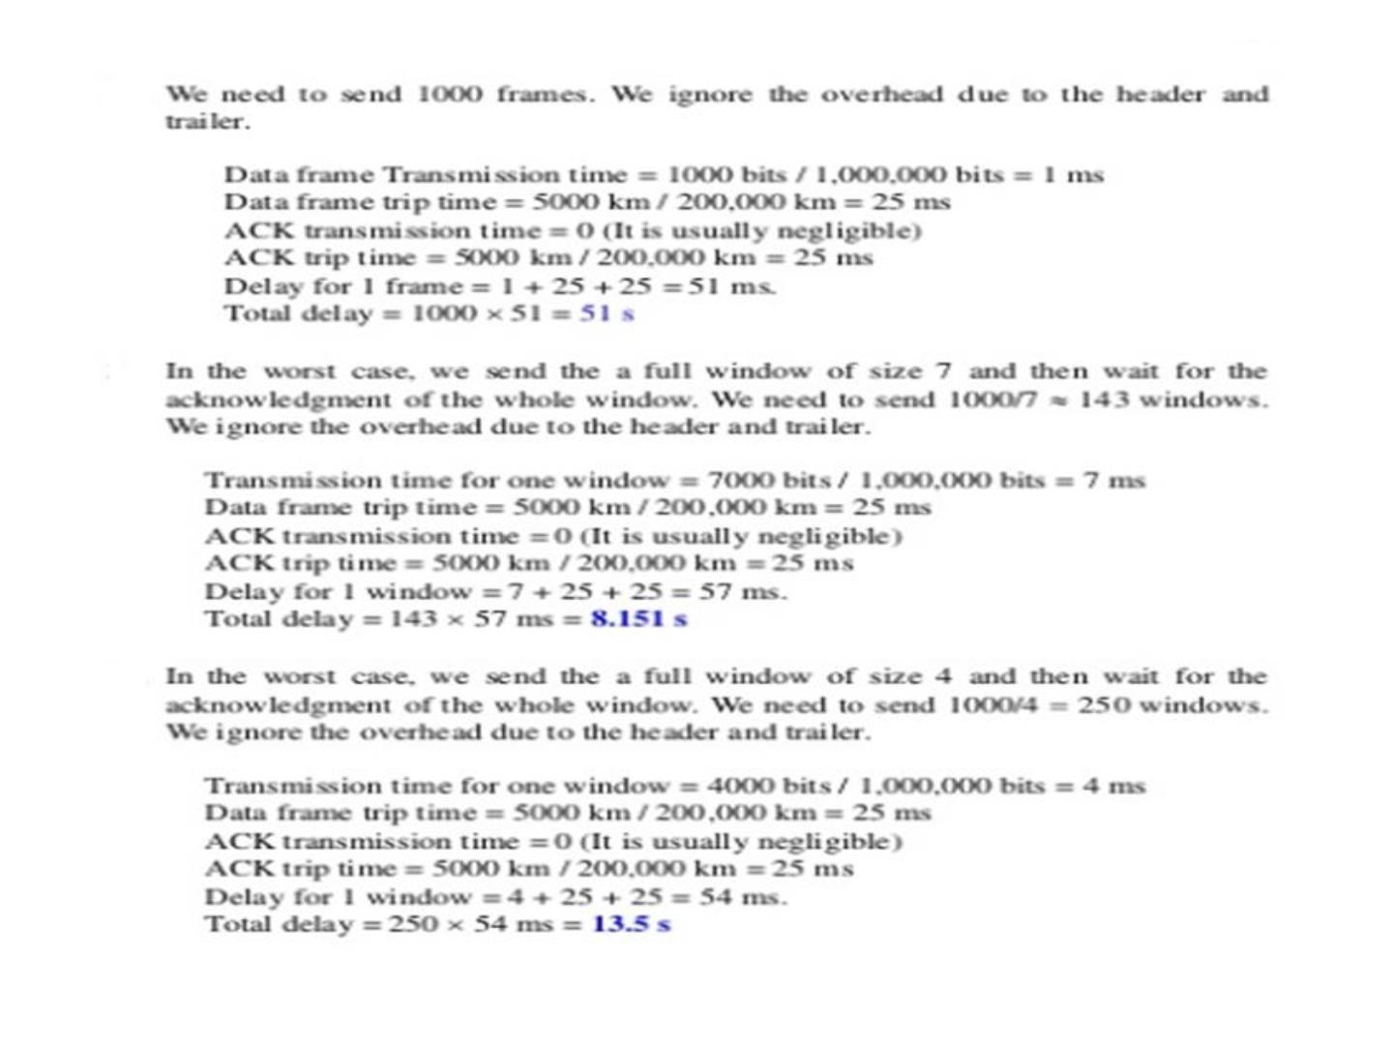
118

